Slide 1
Quantum Computing vs Classical computers: A Theoretical and Empirical Study of Performance, Reliability, and Sustainability
Rehan Arqam (Reg. No: 2339809 ; Roll# 23i-8216)
Supervisor Name: Dr. Zeshan Khan

Slide 2
Continuation* from Previous…
The following feedback and comments were given regarding “thesis – 1 report” in the previous semester:
Need clarity on Evaluation methodology.
Which algorithms to be compared and how?
Which CPU machines (Specs) to be used?
The comparison seems to be of apple and oranges.
Notes:
I have included this portion so that we can start from where we left it. Your experience in research will help me improving this. Regards.

Slide 3
Limitations
The following limitations highlight the gap between the theoretical capabilities of quantum computing and its real-world performance:
Quantum circuit depth
Gate Fidelities
and readout errors

Slide 4
Motivation
1. End of Moore’s Law & limitations in physical strength of Classical computing paradigms
2. Carbon Footprints and their impact on Global environment
3. Device Sustainability & Reliability Concerns
4. The theoretical potential of quantum computing has been widely explored by researchers.

Slide 5
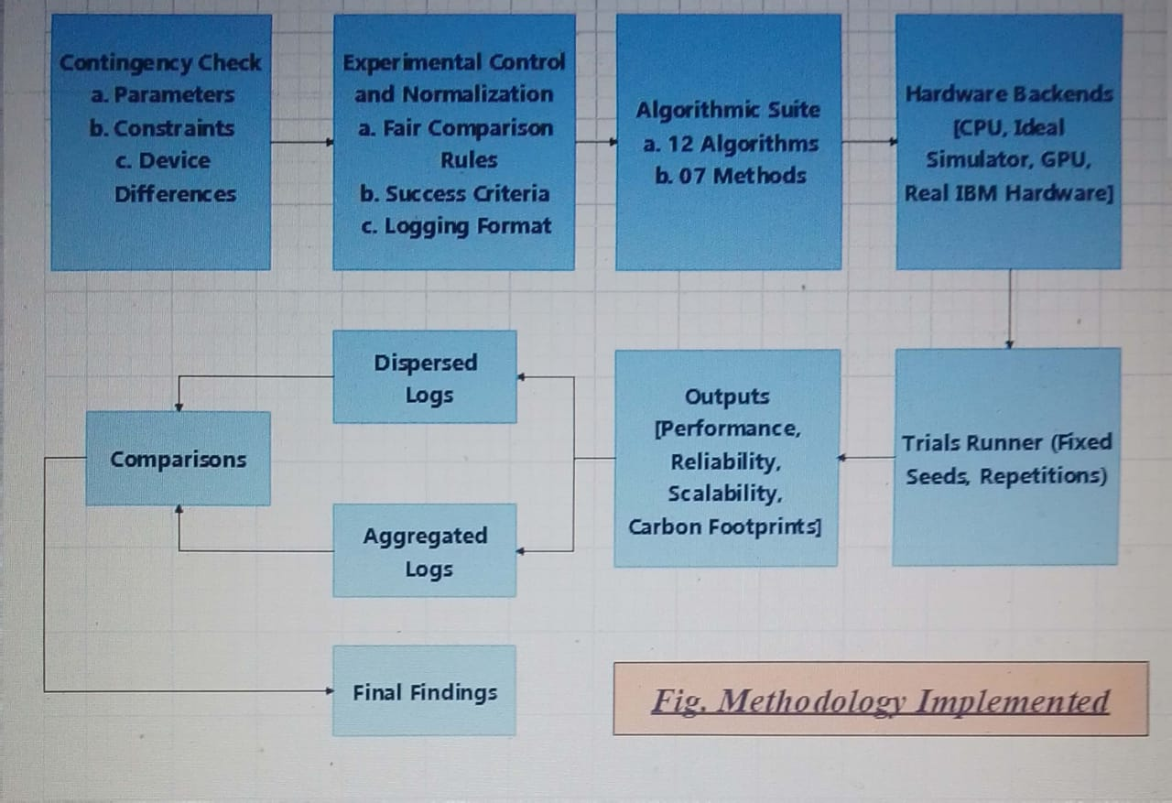
Methodology

Slide 6
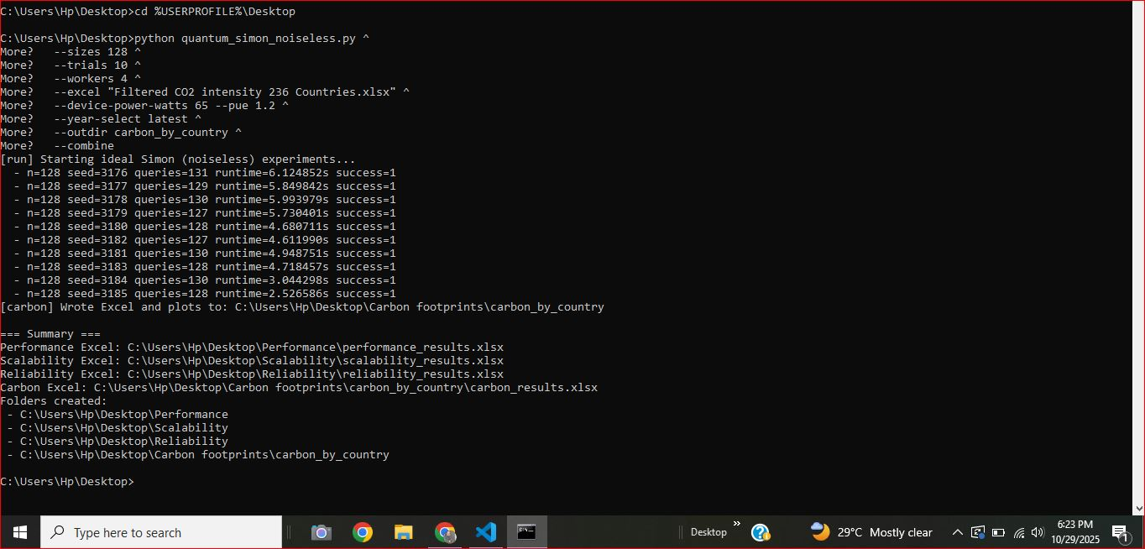
Findings

Slide 7
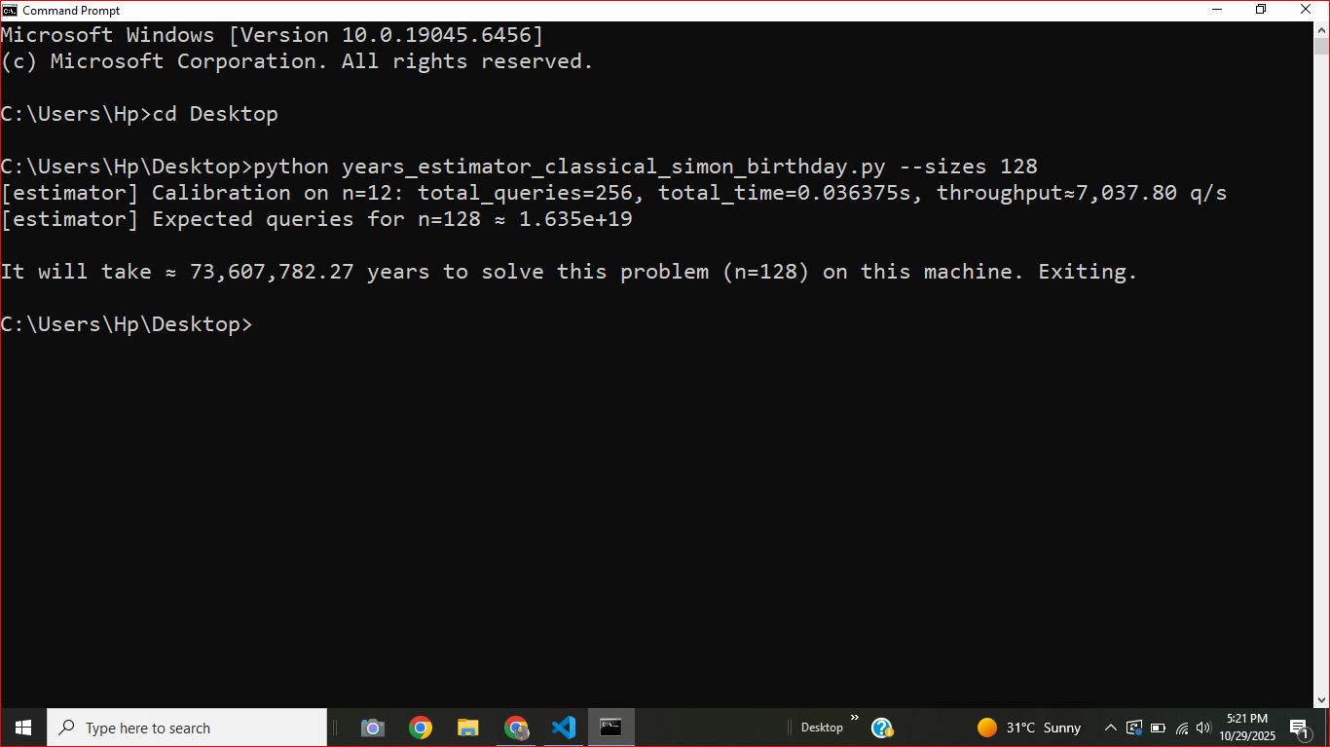
Findings

Slide 8
Results (Reliability of Simon’s Birthday Paradox)
Sr. No. | Algorithm | Hardware | Tested sizes | Theoretical reliability (given) | Empirical reliability (observed success) | Empirical note
1 | Simon’s Algorithm | Classical CPU | n = 6 → 8 → 10 | ~78% | ≈70% → 10% → 0% (mean ≈ 26.7%) | Success collapses quickly as n grows in runs.
2 | Simon’s Algorithm | Ideal noiseless simulator (CPU) | n = 6 → 8 → 10 | ~78% | 100% → 100% → 100% (mean 100%) | Always correct in the tested range (reference “gold standard”).
3 | Simon’s Algorithm | GPU (Tesla T4) | n = 6 → 8 → 10 | ~78% | 100% → 100% → 100% (mean 100%) | Matches ideal-sim correctness in data.
4 | Simon’s Algorithm | Real IBM quantum hardware | n = 6 → 8 → 10 | ~78% | 100% → 100% → 100% (mean 100%) | It stayed fully correct, but slower/overhead-heavy.

Slide 9
Results (Reliability of Quantum Annealing)
Sr. No. | Algorithm | Hardware | Tested sizes | Theoretical reliability (given) | Empirical reliability (observed success) | Empirical note
1 | Quantum Annealing | Classical annealing (CPU) | n = 64 → 128 → 192 | ~75% | ≈40% → 60% → 50% (mean 50%) | Moderate reliability; not consistently optimal.
2 | Quantum Annealing | Ideal noiseless simulator (CPU) | n = 64 → 128 → 192 | ~75% | 100% → 100% → 100% (mean 100%) | Always reaches optimum in my benchmark.
3 | Quantum Annealing | GPU (Tesla T4) | n = 64 → 128 → 192 | ~75% | 100% → 100% → 100% (mean 100%) | Same success profile as ideal sim in experiment runs.
4 | Quantum Annealing | Real IBM quantum hardware | n = 64 → 128 → 192 | ~75% | ≈0% → 0% → 0% (mean 0%) | Reliability effectively fails under my set success criterion (noise/overhead dominated).

Slide 10
Overall Results (Quantum Annealing Algo)
Sr. No. | Hardware | Performance | Reliability | Scalability (n = 64 → 128 → 192) | CO₂ / energy impact
1 | Classical annealing (CPU) | Fastest overall: ≈4 → 11 → 23 s | Medium – success only 40–60%; several runs miss true optimum. | Runtimes grow roughly linearly with n; memory stays small (<0.6 MB). | Lowest (~3.6×10⁻³ kgCO₂e) – best energy efficiency of all four.
2 | Ideal noiseless simulator (CPU) | Moderate speed: ≈4.4 → 16 → 34.9 s | Perfect – 100% success for all sizes, zero gap. | Time grows faster than classical but still in tens of seconds; memory tiny. | Low–moderate ~(5.2×10⁻³ kgCO₂e), ≈1.4× classical CPU.
3 | GPU (Tesla T4) | Slowest simulator: ≈5.2 → 20.1 → 42.6 s | Perfect – 100%. | Runtimes increase similarly or slightly worse than ideal sim | Moderate (~6.5×10⁻³ kgCO₂e), ≈1.8× classical CPU.
4 | Real IBM quantum hardware | Slowest by far: ≈16.3 → 42.2 → 81.2 s | Very low – 0% success; no run reaches the true optimum. | Wall-clock time grows with n and dominated by cloud/control overhead | Highest (~1.32×10⁻² kgCO₂e), about 3–4× classical CPU.

Slide 11
Overall Results (All Algorithms)
Sr. No. | Algorithms | Performance | Reliability | Scalability (problem size ↑) | CO₂ / energy impact
1 | Grover | CPU | All 3 other than Real IBM Hardware | Ideal noiseless simulator | CPU
2 | Shor | Ideal noiseless simulator | Ideal noiseless simulator & GPU (Tesla T4) | GPU (Tesla T4) | Ideal noiseless simulator
3 | CAOA | CPU | Ideal noiseless simulator | CPU | CPU
4 | VQE | CPU | Ideal noiseless simulator | CPU | CPU
Notes:
Real IBM Hardware* by the fitted scaling exponent

Slide 12
Overall Results (All Algorithms) Cont…
Sr. No. | Algorithms | Performance | Reliability | Scalability (problem size ↑) | CO₂ / energy impact
5 | HHL | Ideal noiseless simulator | CPU | Ideal noiseless simulator | Ideal noiseless simulator
6 | DJ | CPU | Ideal noiseless simulator/ Real IBM Hardware | CPU | CPU
7 | Simon’s | CPU | All 3 perfect except CPU | CPU & GPU (Tesla T4) | CPU
8 | Quantum walk | GPU (Tesla T4) | All 3 perfect except CPU | GPU (Tesla T4) | GPU (Tesla T4)

Slide 13
Overall Results (All Algorithms)
Sr. No. | Algorithms | Performance | Reliability | Scalability (problem size ↑) | CO₂ / energy impact
9 | Annealing | CPU | CPU & GPU (Tesla T4) | CPU | CPU
10 | NN | CPU | CPU | CPU | CPU
11 | QSVM | CPU | GPU (Tesla T4) | CPU | CPU
12 | Kmeans | CPU | CPU | CPU | CPU

Slide 14
Overall Results (All Methods)
Sr. No. | Methods | Performance | Reliability | Scalability (problem size ↑) | CO₂ / energy impact
1 | QFT | CPU | Ideal noiseless simulator | CPU | CPU
2 | Amplitude Amplification | CPU | CPU | GPU (Tesla T4) | CPU
3 | Hamiltonian Simulation | Ideal noiseless simulator | Ideal noiseless simulator | Ideal noiseless simulator | Ideal noiseless simulator
4 | Trotterization | CPU | Ideal noiseless simulator | CPU | CPU

Slide 15
Overall Results (All Methods)
Sr. No. | Methods | Performance | Reliability | Scalability (problem size ↑) | CO₂ / energy impact
5 | Adiabetic Evolution | Ideal noiseless simulator | CPU | Ideal noiseless simulator | Ideal noiseless simulator
6 | State Tomography | Ideal noiseless simulator | CPU & GPU (Tesla T4) | Real IBM Hardware | Ideal noiseless simulator
7 | Swap Test | GPU (Tesla T4) | CPU | Real IBM Hardware | GPU (Tesla T4)

Slide 16
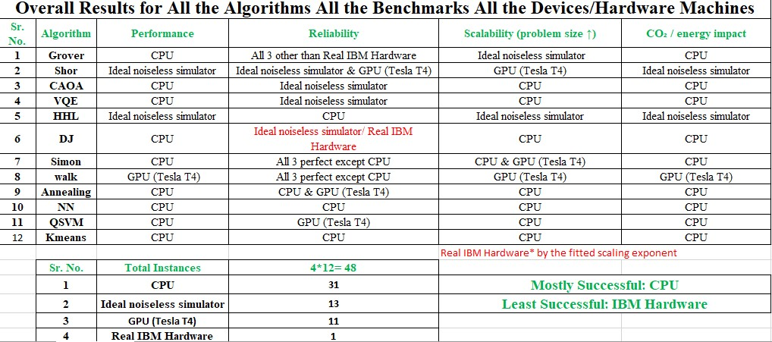
Overall Results (All Algorithms)

Slide 17
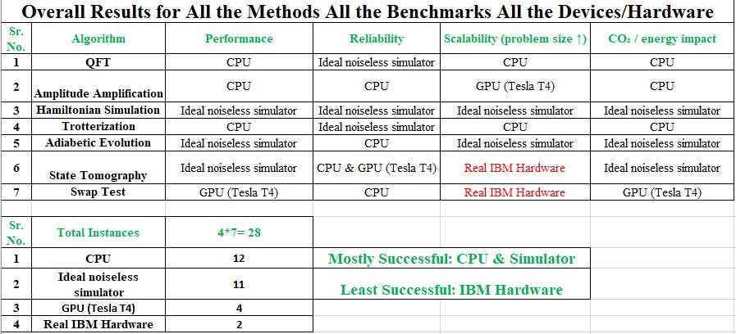
Overall Results (All Methods)

Slide 18
Final Findings (Algorithms)
Total Instances | 4*12= 48
CPU | 31
Ideal noiseless simulator | 13
GPU (Tesla T4) | 11
Real IBM Hardware | 1
Notes:
Total instances 56; Some Hardware share common benchmarking efficiency

Slide 19
Final Findings (Methods)
Total Instances | 4*7= 28
CPU | 12
Ideal noiseless simulator | 11
GPU (Tesla T4) | 4
Real IBM Hardware | 2

Slide 20
Final Findings (Overall)
Most Successful | CPU
Least Successful | Real IBM Quantum Hardware

Slide 21
What the Results Show?
Performance: CPU execution is consistently the most time-efficient end-to-end. GPU and ideal simulators can be competitive for specific configurations.
Reliability depends strongly on N (and steps): As system size N increases, reliability and accuracy become more sensitive to configuration. In general, more steps improve accuracy, but also increase runtime, resource use, and often CO₂.
Scalability is not uniform: Scaling trends differ by platform. CPU tends to scale more smoothly in the tested range, while GPU and hardware show stronger overhead effects and variability.

Slide 22
Conclusion
Across all evaluated benchmarks, the classical CPU is the overall winner in practical terms: it is consistently fastest, most predictable, and typically lowest-impact (energy/CO₂) in our tested ranges.
In contrast, real IBM quantum hardware consistently lags behind simulators and GPU, largely due to noise + execution overhead.
Real IBM hardware is the bottleneck. Hardware runs are dominated by noise, calibration drift, and cloud/control overhead, leading to lower practical performance and higher variance, even when algorithmic scaling should be favorable.
It confirms that current quantum devices are still benchmark platforms, not yet performance platforms, for these workloads.

Slide 23
Final Message
As I proposed in my Thesis-1 proposal, although Moore’s law has reached its physical limits and classical computers are expected to lose their effectiveness, there is a dire need for more efficient and reliable computing paradigms or alternatives (such as quantum computing at present). However, this new paradigm still requires substantial work, corrections, and contributions to demonstrate considerable improvements. Therefore, no clear quantum advantage appears in these experiments when judged by practical metrics (speed, reliability, and overhead), as per the proposition.
Why?
While quantum machines are thousands of times faster than even the fastest supercomputer in the world.

Slide 24
Final Message
Possible Known Reasons:
Processing time by real IBM hardware. The time to upload the jobs on cloud or internet (IBM does not provide public information about it)
Hardware calibration changes over time
Variance among Quantum machine types/processor_types, qubit counts, fault tolerance values’ changes, and many other factors
Concurrent job submission by different researchers at the same backend at the same time
Change in Temperature/Environment of a particular Quantum machine over time

Slide 25
Final Message
However, In some experiments*, real IBM Quantum hardware runs the job within seconds while that particular job would have taken millions of years on other hardware.
Similarly, reliability and scalability results also depend on problem size, hardness of problem, and nature of job etc.
With the public availability of commercial versions of quantum hardware/machines, there will be more improvements.
Notes:
(Screenshot proof has been provided in the previous slides)

Slide 26
Future Work
Quantum benchmarking needs more work.
Right now, results are highly sensitive to:
The problem size (N),
The circuit depth / step count,
Hardware noise and calibration state,
And system overhead (queueing, compilation, runtime control layers).

Slide 27
Please Give Your Feedback!
I would be most obliged if you could provide your valuable feedback, as it would assist me in improving my contributions.

